Slide 1


Towards Transparent and Accurate Diabetes Prediction
Integrating Ensemble Learning and Explainable AI (XAI) for Clinical Trust.
Supervisor: Dr. Khim Chamroeun
Present by: Nhor Povketya

Slide 2
01
Problem
?
RESEARCH PROBLEM
Traditional AI models are "Black Boxes." A doctor cannot trust a "Yes/No" answer without knowing the logic.
!
Key Insight
Diabetes is a global crisis, early, understandable detection can change lives.

Slide 3
02
Research Gap
?
The Limitation
Most current projects focus only on accuracy. They ignore the "Interpretability" (the why).
!
The Solution
This project implements an Ensemble Model (for power) + XAI Tools (for transparency).
!
Goal
Reach >90% accuracy while providing visual proofs for every prediction

Slide 4
03
Dataset
?
Source
Diabetes Binary Health Indicators Dataset (253,680 records).
!
Features
21 health indicators (High BP, Cholesterol, BMI, Smoker, Stroke, Heart Disease, etc.).

Slide 5
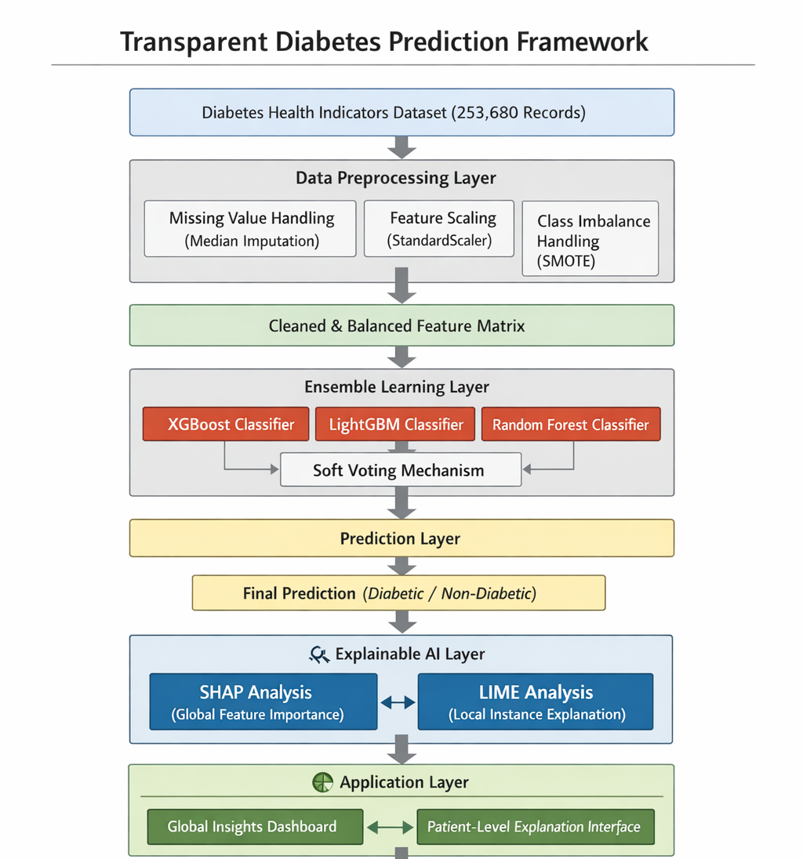
04
Framework

Slide 6
04
Methodology
?
Handling Imbalance
Using SMOTE (Synthetic Minority Over-sampling Technique). We don't just copy data we create new, logical data points to help the AI learn what "Diabetes" looks like
!
Standardization
Using StandardScaler to ensure a "BMI of 30" and "Age of 50" are mathematically comparable.
!
Data Cleaning
Handling missing values via Median Imputation to maintain data integrity.

Slide 7
05
Model Architecture
?
The Ensemble Approach
Using a "Soft Voting" classifier (The Decider)
!
Models
XGBoost: Excellent for speed and performance.
LightGBM: Optimized for speed and large-scale data efficiency
Random Forest: Reduces the risk of "overfitting" (the AI memorizing instead of learning)

Slide 8
06
The "Glass Box" – Explainable AI (XAI)
?
SHAP (Shapley Additive Explanations)
Used for Global understanding. It tells us: "Across the whole country, what are the top 3 causes of diabetes?" (Result: BMI, Age, General Health).
!
LIME (Local Interpretable Model-agnostic Explanations)
Used for Individual understanding. It tells the doctor: "Patient X is at risk specifically because of their high Blood Pressure, even though their BMI is normal."
!
The 90/90 Target
Achieving >90% Accuracy and >90% Interpretability (measured by SHAP consistency).
!
Explainable Dashboard
A prototype interface showing "Local Explanations" (why this patient is sick) and "Global Explanations" (what causes diabetes in the general population).

Slide 9
Thank You

Slide 10
07
Literature Review
Need for Explanations
Popular Tools
Growing interest
The Problem with Previous Research:
They often used only one explanation tool at a time
They used small or limited sets of data
They didn't always check if the explanations themselves were reliable or useful for real doctors
A New Approach: Combine several different explanation tools to give more complete and trustworthy result for healthcare workers

